Slide 1

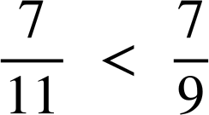
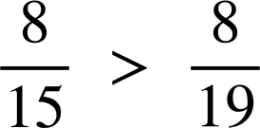
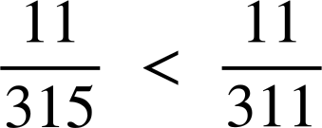
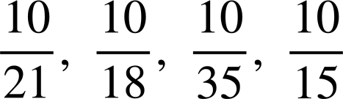
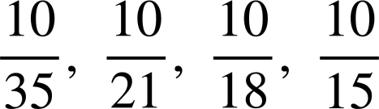
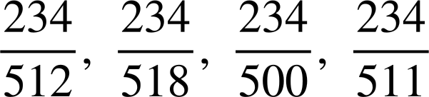
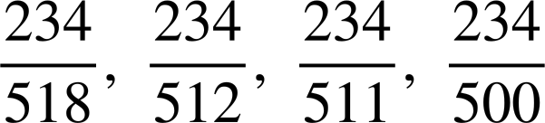



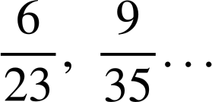
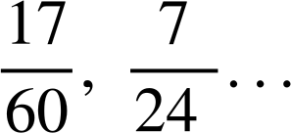

Ordering fractions in different ways
Task A: Comparing fractions using a common numerator
1) Insert either < or > to make the statement true.
a)
c)
b)
d)
e) Place the words ‘larger’ and ‘smaller’ in the sentence:
The larger the denominator the smaller the ‘parts’.
2) Write the following in order from smallest to largest.
a)
b)
3a) Place the words ‘larger’ and ‘smaller’ in the sentence:
is
larger
than
but
smaller
than
.
Jacob
says ‘
is exactly
halfway
between
and
.’
Is he correct?
Jacob is not correct, it is closer to
Find
another
fraction
between
and
.
e.g.
Find
a
fraction
that
is
closer
to
.
e.g.
Find the fraction that is exactly halfway
between
and
.

Slide 2
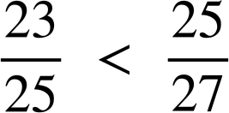
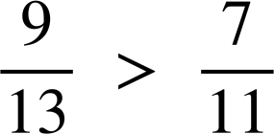
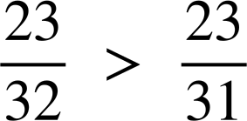
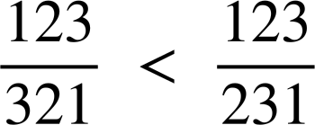
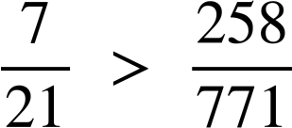
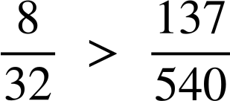
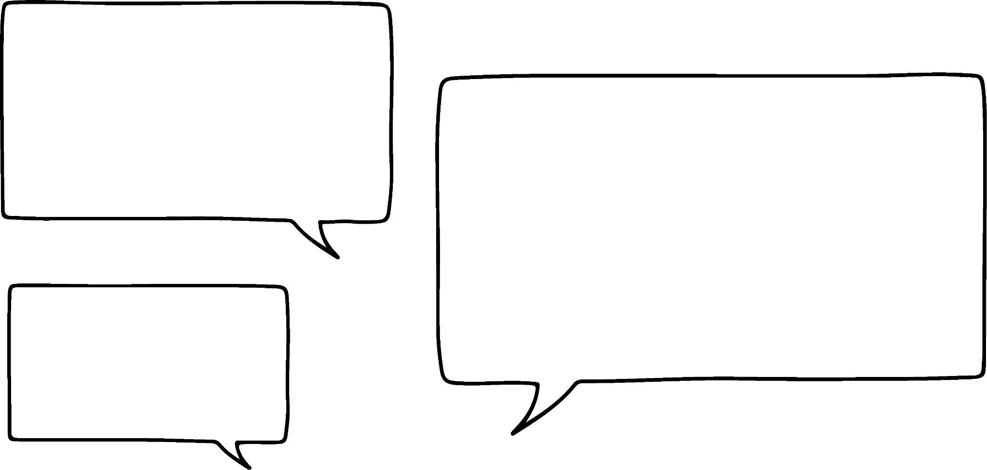





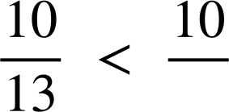
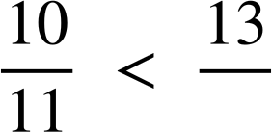
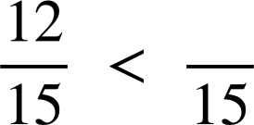
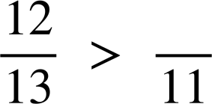
Ordering fractions in different ways
Task B: Ordering by comparing to one
1) Choose the most appropriate method to decide which of the following statements are true.
a)
True
d)
True
b)
False
e)
True
c)
False
f)
False
2) Explain why Aisha is wrong.
is larger than
Aisha
E.g. Although they are both 3 ‘parts’ away from 1, the ‘parts’ are larger in so it further from 1.
3) Use these numbers to complete the following proper fractions. 10, 11, 12, 13, 14 and 15.
The fraction closest to one
The fraction closest to zero
e)
11 or 12
14 or 15
d)
13 or 14
10
f)
Mathematics in Education and Industry
v2.2

